Slide 1
PhaseIII: Logical Model Design
pbmn diagram phase 2

Slide 2
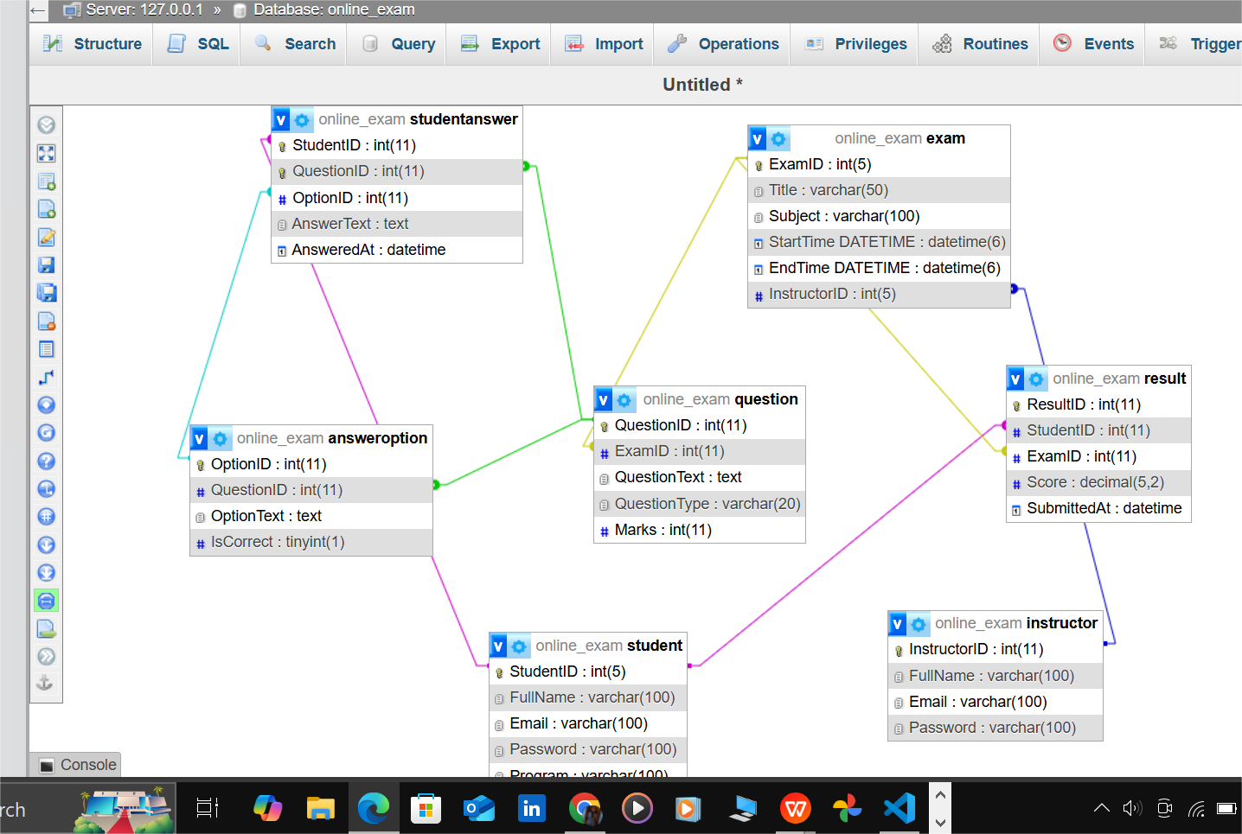
LOGICAL MODEL DIAGRAM

Slide 3
Exams Scenario 1: A student takes multiple
Handled by: Result table
A student can take many exams; each record in Result connects a StudentID to an ExamID with the associated score.

Slide 4
Scenario 2: One exam has multiple types of questions (MCQs and Essays)
Handled by: Question table with QuestionType field
The CHECK constraint ensures that only allowed types ('MCQ', 'Essay') are accepted.

Slide 5
Scenario 3: An MCQ question has multiple answer options, but only one is correct
Handled by: AnswerOption table with IsCorrect boolean
Each QuestionID can have multiple AnswerOptions, but only one can be TRUE.

Slide 6
Scenario 4: A student answers both MCQs and essay questions
Handled by: StudentAnswer table
If QuestionType is 'MCQ' → OptionID is filled.
If 'Essay' → AnswerText is used instead.
Composite PK ensures each student answers a question only once.

Slide 7
Scenario 5: Instructor creates and schedules exams
Handled by: Exam table linked to InstructorID
StartTime and EndTime allow precise scheduling with time constraints validated by CHECK (EndTime > StartTime).

